Slide 1
RGB-D Images and Applications
Yao Lu

Slide 2
Outline
Overview of RGB-D images and sensors
Recognition: human pose, hand gesture
Reconstruction: Kinect fusion

Slide 3
Outline
Overview of RGB-D images and sensors
Recognition: human pose, hand gesture
Reconstruction: Kinect fusion

Slide 4
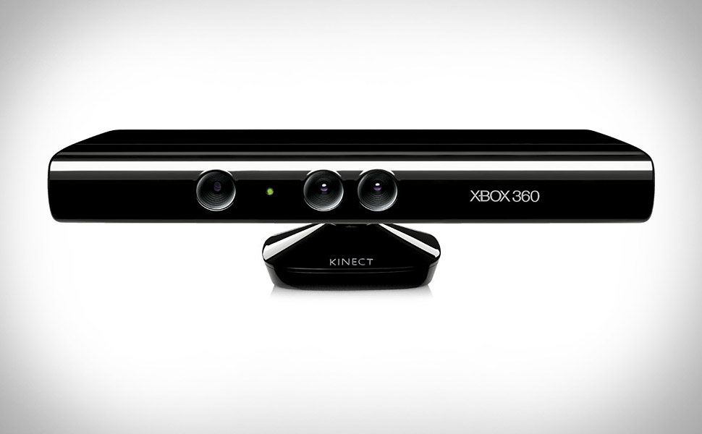
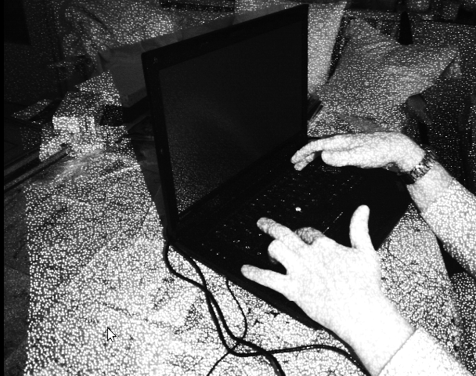
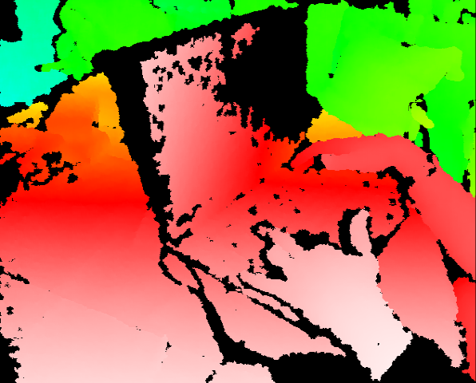

Slide 5
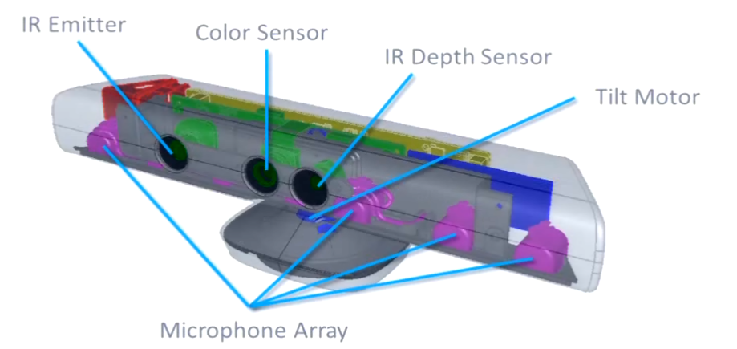
How does Kinect work?
Kinect has 3 components :-
color camera ( takes RGB values)
IR camera ( takes depth data )
Microphone array ( for speech recognition )

Slide 6
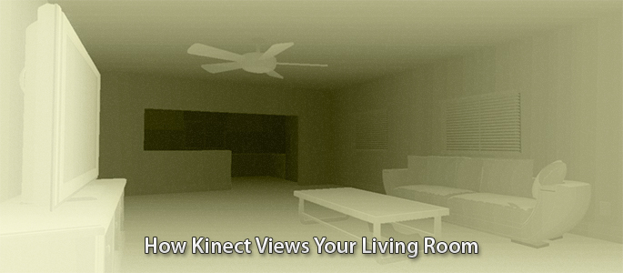
Depth Image

Slide 7
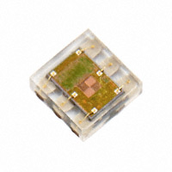
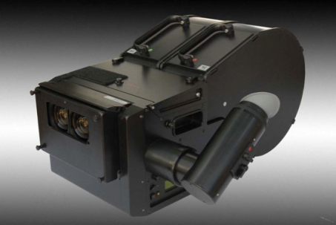
How Does the Kinect Compare?
Distance Sensing
Alternatives Cheaper than Kinect
~$2 Single-Point Close-Range Proximity Sensor
Motion Sensing and 3D Mapping
High Performing Devices with Higher Cost
Good Performance for Distance and Motion Sensing
Provides a bridge between low cost and high performance sensors

Slide 8
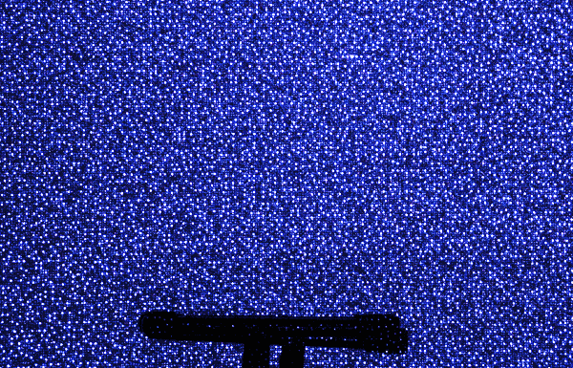
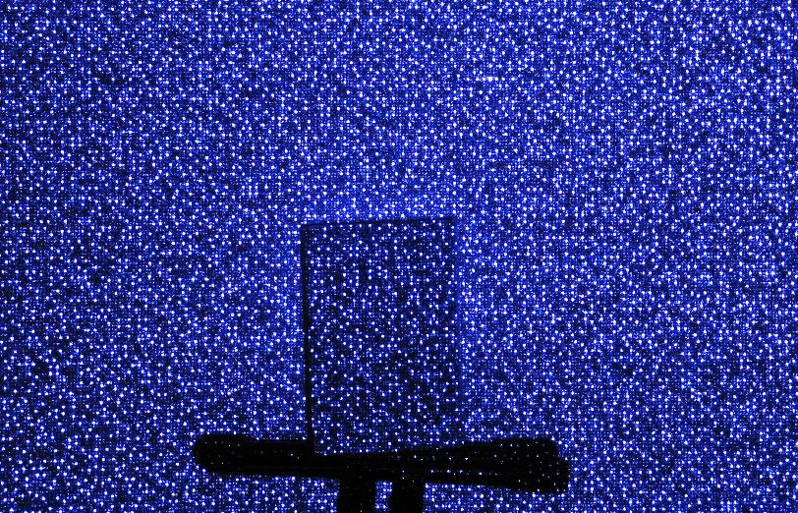
Depth Sensor
IR projector emits predefined Dotted Pattern
Lateral shift between projector and sensor
Shift in pattern dots
Shift in dots determines Depth of Region

Slide 9
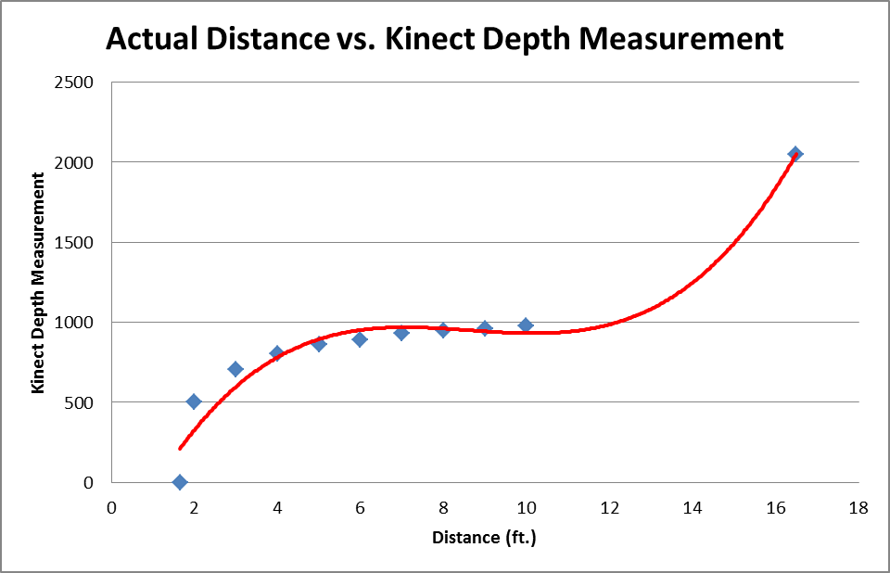
Kinect Accuracy
OpenKinect SDK
11 Bit Accuracy
2¹¹ = 2048 possible values
Measured Depth
Calculated 11 bit value
2047 = maximum distance
Approx. 16.5 ft.
0 = minimum distance
Approx. 1.65 ft.
Reasonable Range
4 – 10 feet
Provides Moderate Slope
Values from: http://mathnathan.com/2011/02/depthvsdistance/

Slide 10
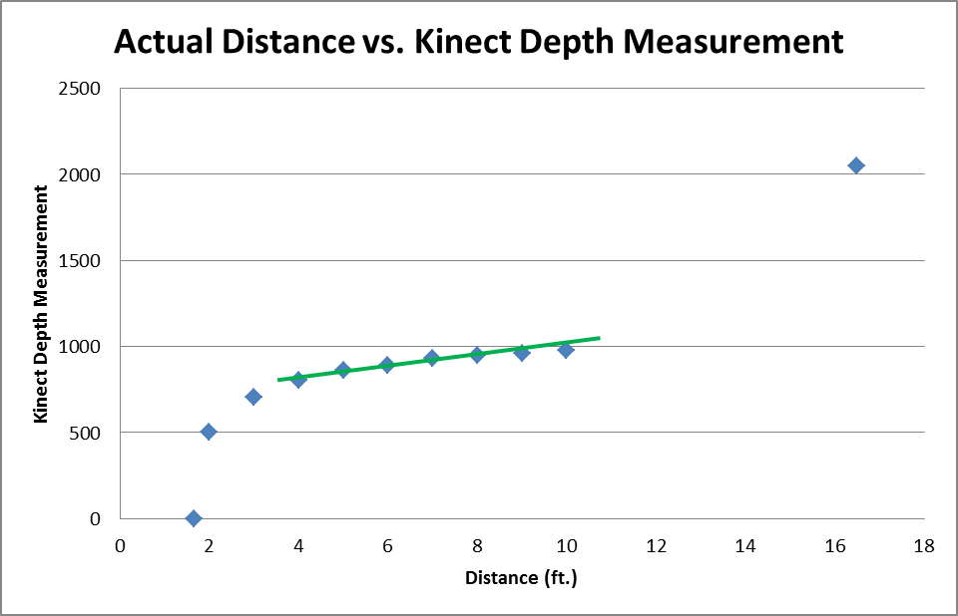
Kinect Accuracy
OpenKinect SDK
11 Bit Accuracy
2¹¹ = 2048 possible values
Measured Depth
Calculated 11 bit value
2047 = maximum distance
Approx. 16.5 ft.
0 = minimum distance
Approx. 1.65 ft.
Reasonable Range
4 – 10 feet
Provides Moderate Slope
Values from: http://mathnathan.com/2011/02/depthvsdistance/

Slide 11
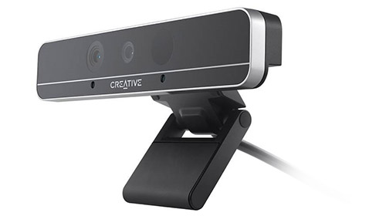
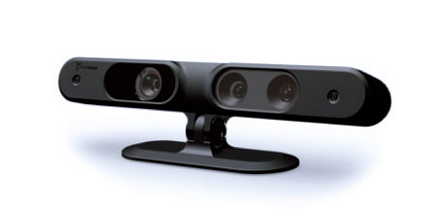
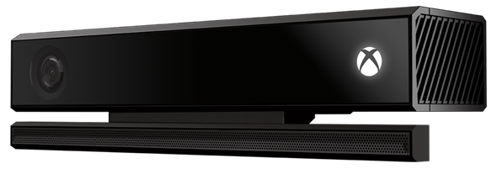
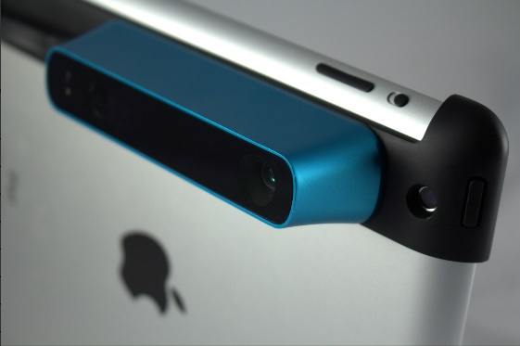
Other RGB-D sensors
Intel RealSense Series
Asus Xtion Pro
Microsoft Kinect V2
Structure Sensor

Slide 12
Outline
Overview of RGB-D images and sensors
Recognition: human pose, hand gesture
Reconstruction: Kinect fusion

Slide 13
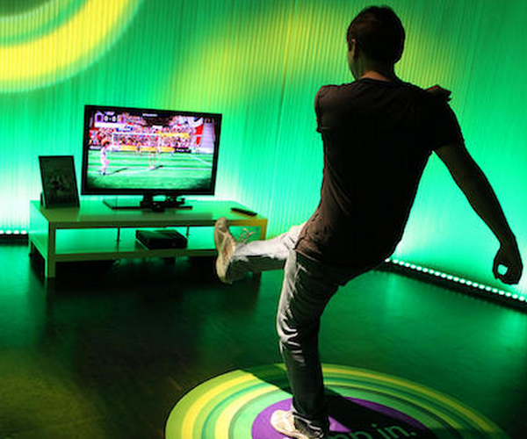
Recognition: Human Pose recognition
Research in pose recognition has been on going for 20+ years.
Many assumptions: multiple cameras, manual initialization, controlled/simple backgrounds

Slide 14
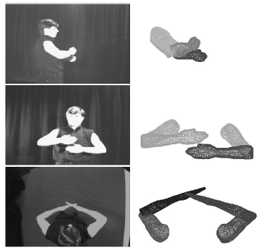
Model-Based Estimation of 3D Human Motion, Ioannis Kakadiaris and Dimitris Metaxas, PAMI 2000

Slide 15
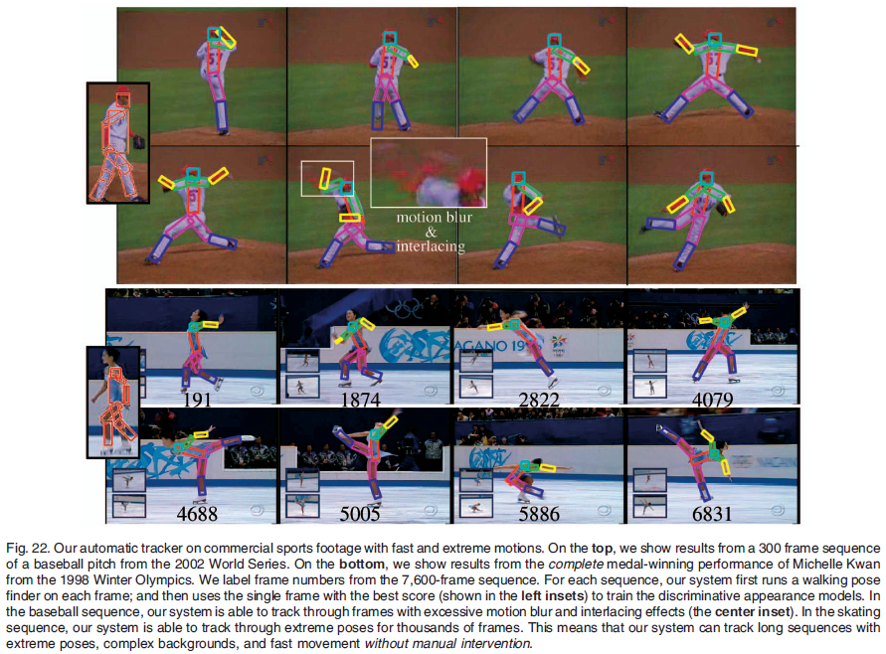
Tracking People by Learning Their Appearance, Deva Ramanan, David A. Forsyth, and Andrew Zisserman, PAMI 2007

Slide 16
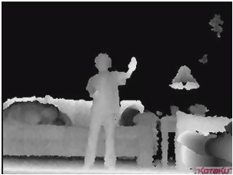
Kinect
Why does depth help?

Slide 17
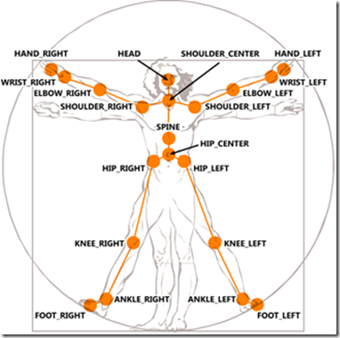
Algorithm design
Shotton et al. proposed two main steps:
1. Find body parts
2. Compute joint positions.
Real-Time Human Pose Recognition in Parts from Single Depth Images
Jamie Shotton Andrew Fitzgibbon Mat Cook Toby Sharp Mark Finocchio
Richard Moore Alex Kipman Andrew Blake, CVPR 2011

Slide 18
Finding body parts
What should we use for a feature?
What should we use for a classifier?

Slide 19
Finding body parts
What should we use for a feature?
Difference in depth
What should we use for a classifier?
Random Decision Forests
A set of decision trees

Slide 20
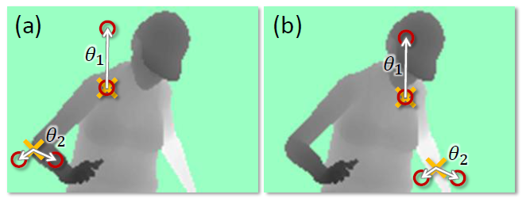
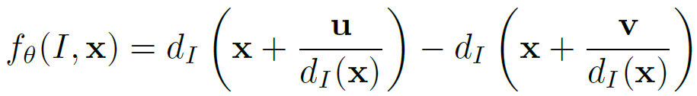
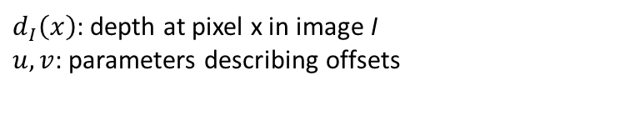
Features
$d_{I}\left(x\right)$: depth at pixel x in image I
$u, v$: parameters describing offsets

Slide 21
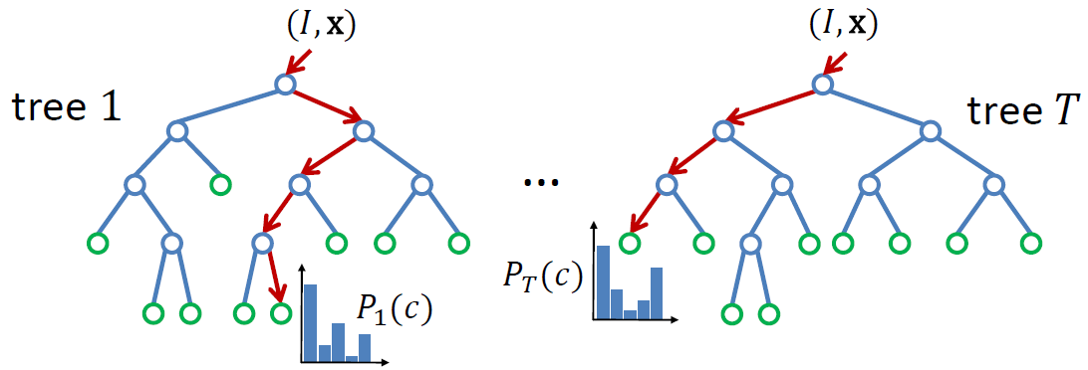
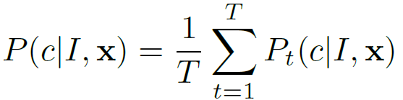
Classification
Learning:
Randomly choose a set of thresholds and features for splits.
Pick the threshold and feature that provide the largest information gain.
Recurse until a certain accuracy is reached or depth is obtained.

Slide 22
Implementation details
3 trees (depth 20)
300k unique training images per tree.
2000 candidate features, and 50 thresholds
One day on 1000 core cluster.

Slide 23
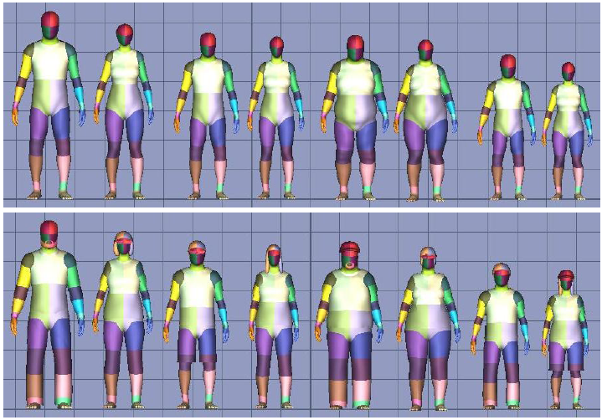
Synthetic data

Slide 24
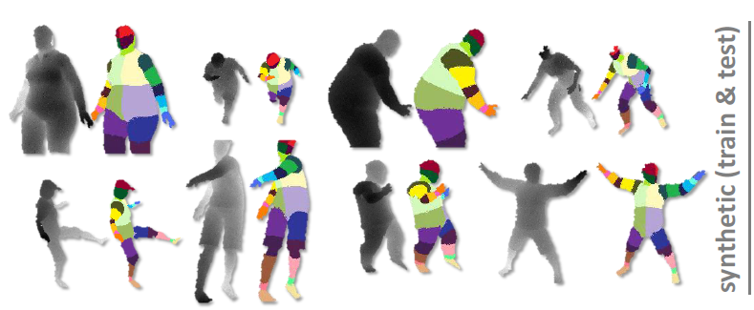
Synthetic training/testing

Slide 25
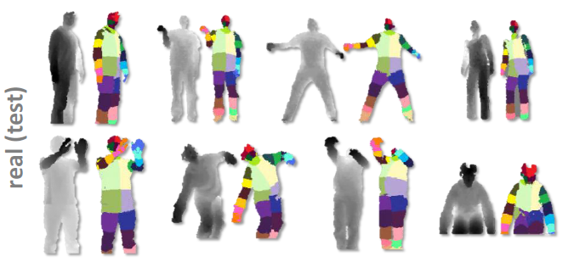
Real test

Slide 26
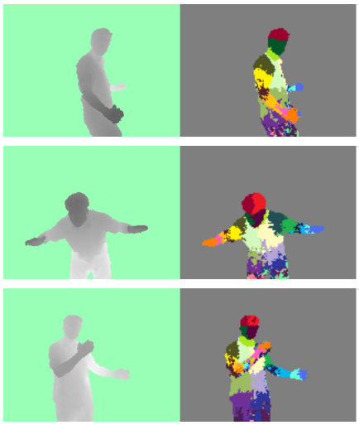
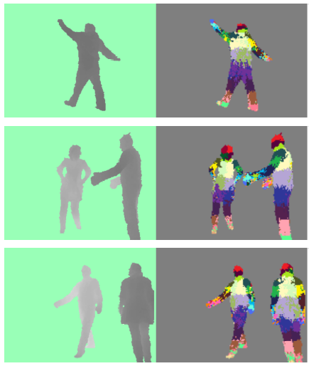
Results

Slide 27
Estimating joints
Apply mean-shift clustering to the labeled pixels.
“Push back” each mode to lie at the center of the part.

Slide 28
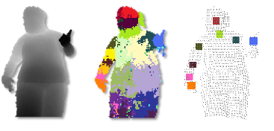
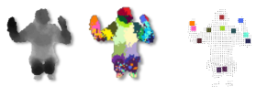
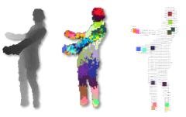
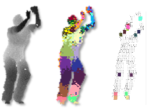
Results

Slide 29
Outline
Overview of RGB-D images and sensors
Recognition: human pose, hand gesture
Reconstruction: Kinect fusion

Slide 30

Hand gesture recognition

Slide 31
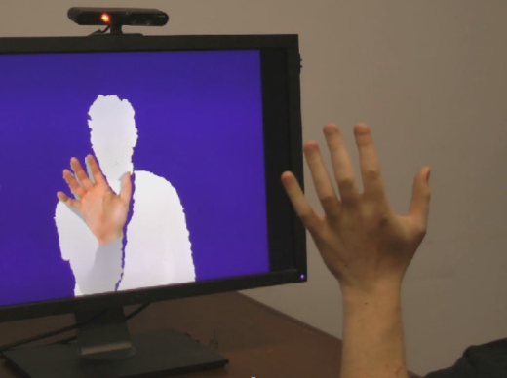
Hand Pose Inference
Target: low-cost markerless mocap
Full articulated pose with high DoF
Real-time with low latency
Challenges
Many DoF contribute to model deformation
Constrained unknown parameter space
Self-similar parts
Self occlusion
Device noise

Slide 32
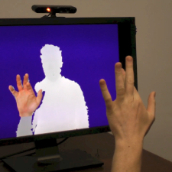
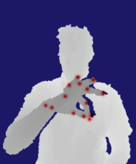
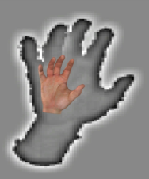
Pipeline Overview
Tompson et al. Real-time continuous pose recovery of human hands using convolutional networks. ACM SIGGRAPH 2014.
Supervised learning based approach
Needs labeled dataset + machine learning
Existing datasets had limited pose information for hands
Architecture
RDF
HAND DETECT
CONVNET JOINT DETECT
INVERSE KINEMETICS
POSE
OFFLINE DATABASE CREATION

Slide 33
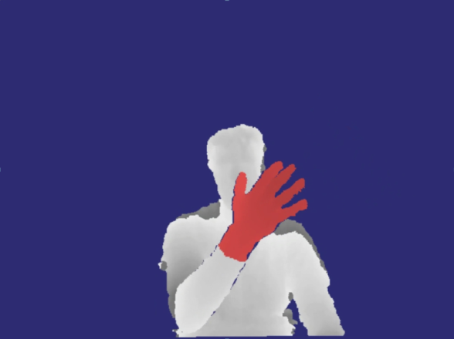
Pipeline Overview
Supervised learning based approach
Needs labeled dataset + machine learning
Existing datasets had limited pose information for hands
Architecture
RDF
HAND DETECT
CONVNET JOINT DETECT
INVERSE KINEMETICS
POSE
OFFLINE DATABASE CREATION

Slide 34
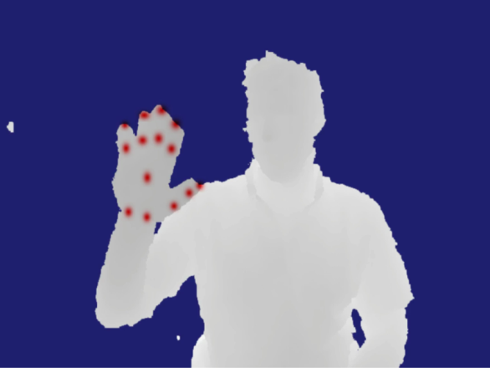
Pipeline Overview
Supervised learning based approach
Needs labeled dataset + machine learning
Existing datasets had limited pose information for hands
Architecture
RDF
HAND DETECT
CONVNET JOINT DETECT
INVERSE KINEMETICS
POSE
OFFLINE DATABASE CREATION

Slide 35
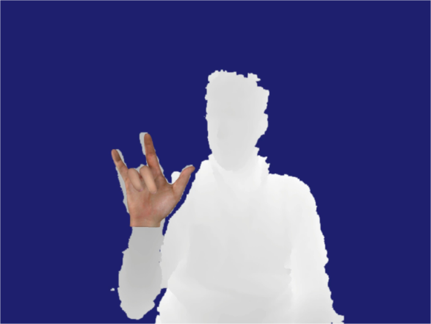
Pipeline Overview
Supervised learning based approach
Needs labeled dataset + machine learning
Existing datasets had limited pose information for hands
Architecture
RDF
HAND DETECT
CONVNET JOINT DETECT
INVERSE KINEMETICS
POSE
OFFLINE DATABASE CREATION

Slide 36
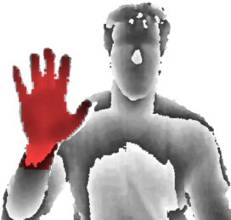
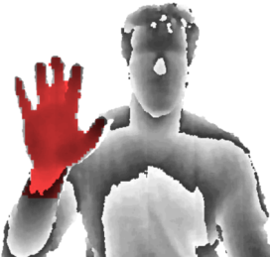
RDF Hand Detection
Per-pixel binary classification → Hand centroid location
Randomized decision forest (RDF)
Shotton et al.^{[1]}
Fast (parallel)
Generalize
Target
Inferred
RDT1
RDT2
+
P(L | D)
Labels
[1] J. Shotten et al., Real-time human pose recognition in parts from single depth images, CVPR 11

Slide 37
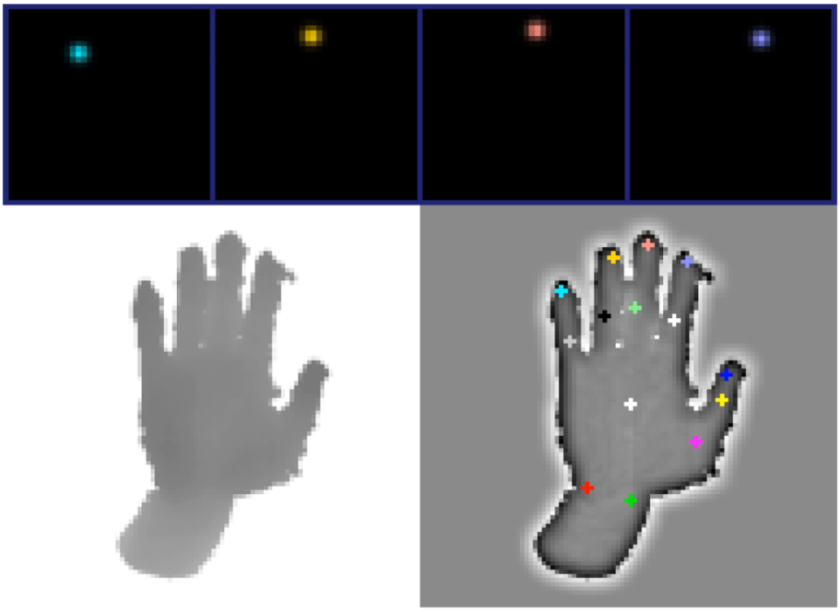
Inferring Joint Positions
96x96
ConvNet Detector 1
Image Preprocessing
48x48
ConvNet Detector 2
2 stage Neural Network
ConvNet Detector 3
24x24
HeatMap
PrimeSense
Depth
ConvNet
Depth

Slide 38
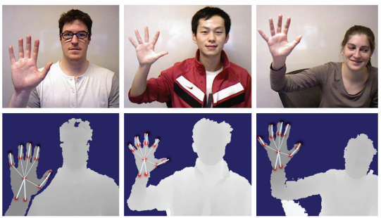
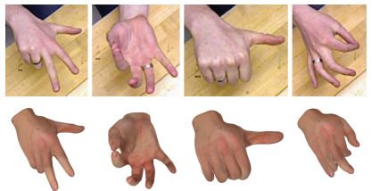
Hand Pose Inference
Results

Slide 39
Outline
Overview of RGB-D images and sensors
Recognition: human pose, hand gesture
Reconstruction: Kinect fusion

Slide 40
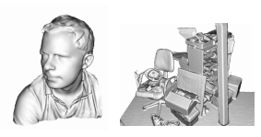
Reconstruction: Kinect Fusion
Newcombe et al. KinectFusion: Real-time dense surface mapping and tracking. 2011 IEEE International Symposium on Mixed and Augmented Reality.
https://www.youtube.com/watch?v=quGhaggn3cQ

Slide 41
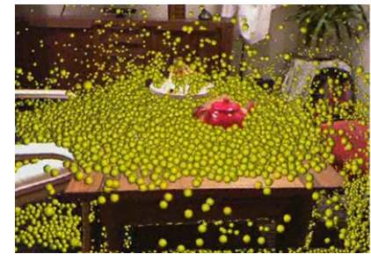
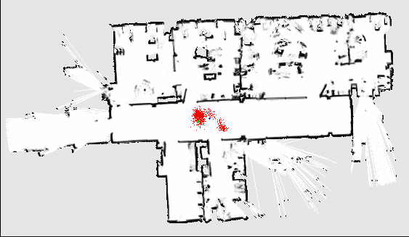
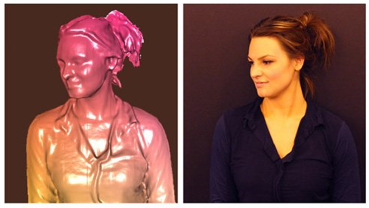
Motivation
Augmented Reality
Robot Navigation
3d model scanning
Etc..

Slide 42
Challenges
Tracking Camera Precisely
Fusing and De-noising Measurements
Avoiding Drift
Real-Time
Low-Cost Hardware

Slide 43
Proposed Solution
Fast Optimization for Tracking, Due to High Frame Rate.
Global Framework for fusing data
Interleaving Tracking & Mapping
Using Kinect to get Depth data (low cost)
Using GPGPU to get Real-Time Performance (low cost)

Slide 44

Method

Slide 45


Tracking
Finding Camera position is the same as fitting frame’s Depth Map onto Model
Tracking
Mapping

Slide 46

Tracking – ICP algorithm
icp = iterative closest point
Goal: fit two 3d point sets
Problem: What are the correspondences?
Kinect fusion chosen solution:
Start with
Project model onto camera
Correspondences are points with same coordinates
Find new T with Least - Squares
Apply T, and repeat 2-5 until convergence
Tracking
Mapping

Slide 47

Tracking – ICP algorithm
icp = iterative closest point
Goal: fit two 3d point sets
Problem: What are the correspondences?
Kinect fusion chosen solution:
Start with
Project model onto camera
Correspondences are points with same coordinates
Find new T with Least - Squares
Apply T, and repeat 2-5 until convergence
Tracking
Mapping

Slide 48

Tracking – ICP algorithm
Assumption: frame and model are roughly aligned.
True because of high frame rate
Tracking
Mapping

Slide 49

Mapping
Mapping is Fusing depth maps when camera poses are known
Model from existing frames
New frame
Problems:
measurements are noisy
Depth maps have holes in them
Solution:
using implicit surface representation
Fusing = estimating from all frames relevant
Tracking
Mapping

Slide 50


Mapping – surface representation
Surface is represented implicitly - using Truncated Signed Distance Function (TSDF)
Voxel grid
Tracking
Mapping
Numbers in cells measure voxel distance to surface – D

Slide 51

Mapping
Tracking
Mapping

Slide 52

Mapping
Tracking
Mapping
d= [pixel depth] – [distance from sensor to voxel]

Slide 53

Mapping
Tracking
Mapping

Slide 54

Mapping
Tracking
Mapping

Slide 55

Mapping
Tracking
Mapping

Slide 56
Method

Slide 57
Pros & Cons
Pros:
Really nice results!
Real time performance (30 HZ)
Dense model
No drift with local optimization
Robust to scene changes
Elegant solution
Cons :
3d grid can’t be trivially up-scaled

Slide 58
Limitations
doesn’t work for large areas (Voxel-Grid)
Doesn’t work far away from objects (active ranging)
Doesn’t work out-doors (IR)
Requires powerful Graphics card
Uses lots of battery (active ranging)
Only one sensor at a time

